Slide 1


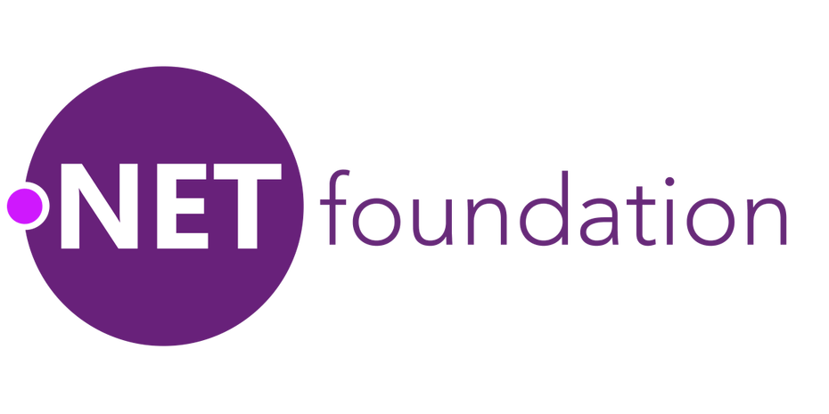

Capabilities
a toolkit for building cloud-native .NET microservices

Slide 2
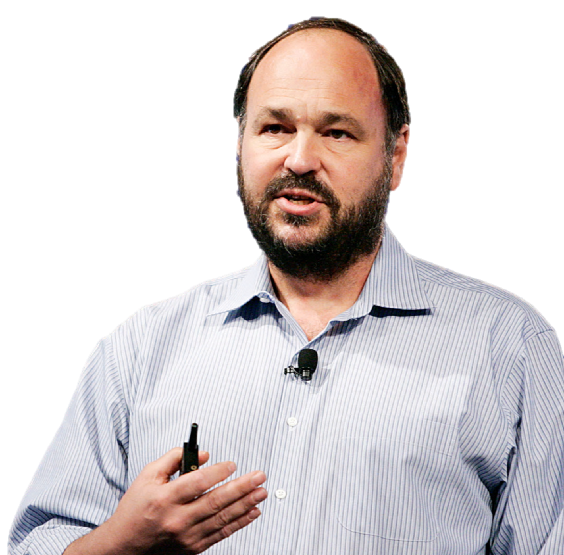

the Cloud isn’t about
where
computing is done,
rather
how it’s done.
– Paul Maritz
Notes:
Pivotal founder and chairman of the board Paul Maritz famously said that the Cloud isn’t about where computing is done, but rather how it’s done.
In other words, the value you get from moving existing IT workloads off-premise, to the cloud,
pales in comparison to the value you can unlock by doing new things that the cloud makes possible,
things that were never possible before with legacy technologies.

Slide 3
But how? → Cloud-Native
The cloud encourages new design principles
12 Factors (Heroku)
Cloud-Native principles
enabling you to
do new things
Notes:
The cloud encourages a new set of design principles.
The folks at Heroku called them the 12 Factors, at Pivotal we call them Cloud-Native principles but what they have in common is they help you build applications that are MASSIVELY horizontally scalable, resilient and self-healing, almost always available and most importantly
They allow you to build new things.
Connect with customers in new ways.
In other words, the cloud is about building business-differentiating software.

Slide 4
What even is Cloud-Native .NET?
These principles may seem foreign to .NET devs
Configuration stored in environment variables
Out of process session state
No r/w to registry, GAC, Local file system
Loosely coupled backing services (i.e. RDBMS)
That’s why we built Steeltoe
Notes:
This stuff might be old hat for Java devs--Spring Boot makes pretty much all this happen automagically--but it might seem opaque and unintuitive for .NET developers.
You've got to
explicitly declare all dependencies,
externalize configuration into the environment,
save your session state out of process,
break any tight coupling between your app and the server it's running on (like the registry, GAC, or the local file system)
and if you're using a data store (e.g. RDBMS) then it needs to be loosely coupled, explicitly declared and treated as an externalized backing service.
That's why we built Steeltoe...

Slide 5
What even is Cloud-Native .NET?
These principles may seem foreign to .NET devs
Configuration stored in environment variables
Out of process session state
No r/w to registry, GAC, Local file system
Loosely coupled backing services (i.e. RDBMS)
That’s why we built Steeltoe
(Well, there’s actually another reason too...)
Notes:
Well wait. There's actually another reason too.

Slide 6
Microservices
Microservice architectures have many benefits
Quickly iterate and release frequently
Easy for new devs to join and be productive
Increased developer velocity
Shorter test cycles
Polyglot becomes reality
Independently scalable components
Notes:
The world is moving to Microservices and there's good reason for it.
By decoupling discrete pieces of application functionality and enforcing explicit contracts between them (e.g. REST APIs) Microservice architectures afford a much greater agility for development teams. Release cycles can run independently for different components. A smaller code base means new developers can join a project team more easily (without having to spend months or years learning a massive monolithic code base in order to be productive); developer velocity increases; test cycles get shorter; continuous delivery becomes possible; A/B testing; finally you can iterate fast enough to develop business differentiating technology.
Microservice architectures also mean that you can choose the language and tooling that makes sense for a given service (maybe one component has dependencies that require full-framework .NET on Windows, while another one could be written in .NET Core running on Linux or even Node). And when your application is running you have the ability to scale those various components independently.

Slide 7
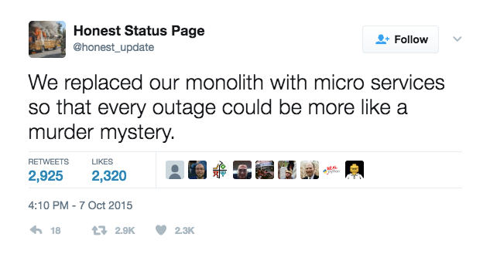
But Microservices are hard
Microservices = Distributed Systems = Way more complexity
How to troubleshoot microservices?
How to set global configuration across the whole application?
How to look up the dynamic addresses of services you consume?
What do you do when a service you depend on stops responding?
Notes:
But microservice architectures are distributed systems. And distributed systems have way more complexity than a monolith.
Trying to find a bug in your monolith? Chances are, it's in your monolith. Troubleshooting microservices can be kind of like solving a murder mystery.
In your monolith it's easy to set global configuration and read it from anywhere. But how do you share configuration settings across microservices?
And if a microservice you depend on is running at horizontal scale, dynamically adding and subtracting instances, how do you find the address of a healthy instance?
And how do you make your application behave gracefully if there are no healthy instances? If a service you depend on stops responding

Slide 8
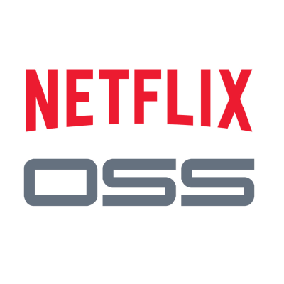

The good news is...
There are some great OSS solutions to these problems available from
and
But until now they’ve been focused on Java and not very accessible to .NET devs…
Notes:
The good news is that these problems have already been solved. For resiliency in their massive video streaming platform Netflix created Eureka for service discovery and the Hystrix circuit-breaker. Twitter created Zipkin to aid in distributed tracing across microservices; the Spring Cloud team added SCCS a version-controlled centralized configuration repo; and more importantly they made all these tools easily consumable for everyone (as long as you're a Java developer).

Slide 9
So that’s why we built Steeltoe
To help you build
Cloud native .NET applications (for Cloud Foundry)
that can leverage Spring Cloud tooling for
resilient microservices
Notes:
To enable .NET developers to build Cloud-Native apps targeting Cloud Foundry
and enable them to leverage Spring Cloud and Spring Cloud Services tooling for resilient microservices.
Story of why we call it “Steeltoe”

Slide 10
What’s inside the box?

Slide 11
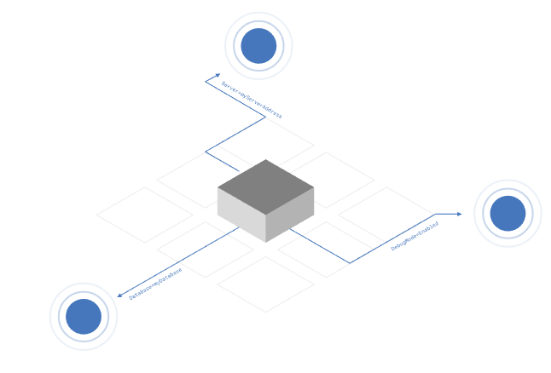
Configuration Providers
Cloud Foundry
VCAP_APPLICATION, VCAP_SERVICES, CF_*
Config Server
Access config stored in Spring Cloud Config Server (backed by Git, Vault, local filesystem)
Across all instances, all apps, all environments
Notes:
We build on the Configuration API provided by .NET which enables you to pull values from different sources using Configuration Providers.
Each provider supports reading a set of name-value pairs from a different source location; adding them into a combined multi-level configuration dictionary.
Out of the box, .NET supports getting configuration from:
Command-line arguments
File sources (e.g. JSON, XML and INI)
Environment variables
Custom providers
Steeltoe adds two additional providers to that list:
Cloud Foundry Provider
This provider enables the standard Cloud Foundry environment variables, VCAP_APPLICATION, VCAP_SERVICES and CF_* to be parsed and accessed as configuration data.
Config Server Provider
This provider enables the Spring Cloud Config Server to be used as a source of configuration data for a .NET application.
Steeltoe’s configuration supports both reading the config values directly, as well as Dependency Injection with the Options framework

Slide 12
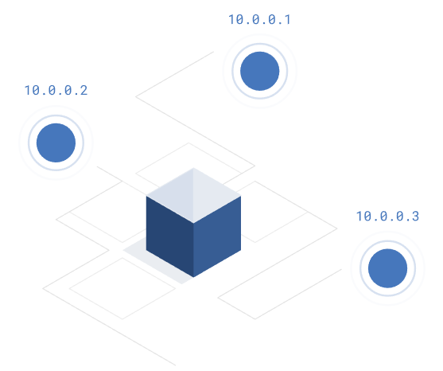
Service Discovery
Service Discovery Client
.NET client for Netflix Eureka
Implements Service Discovery design pattern
Dynamically discover and call registered services
Notes:
As services scale in and out, you need a way to look up instance addresses.
Trying to hand-configure each client of a service or adopt some form of access convention can be difficult and prove to be brittle in production. Instead, applications can use a service registry to dynamically discover and call registered services.
There are several options to choose from when implementing the Service Discovery pattern. Steeltoe has initially chosen to support one based on Eureka; using Netflix’s Service Discovery server and client.

Slide 13

Circuit Breaker
Circuit Breaker Client
.NET implementation of Netflix Hystrix
Bypass failing services with elegant fall-back behavior (so your users don’t see nasty error messages)
Rich metrics and monitoring

Slide 14
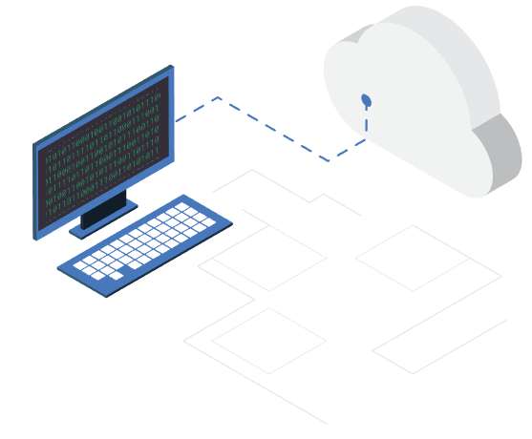
Cloud Connectors
Connectors for common data services
MySQL
Postgres
MS-SQL
Redis
RabbitMQ
OAuth (for UAA or Pivotal Single Sign-on)
Notes:
Steeltoe Connectors simplify the process of connecting to and using backing data services on Cloud Foundry.
They provide out-of-the-box support for discovering many common services on Cloud Foundry.
They also include the ability to use settings-based configuration so developers can supply configuration settings at development and testing time, but then have those settings overridden when pushing the application to Cloud Foundry.

Slide 15

Security Providers
OAuth2 SSO Provider
JWT resource protection
Redis Key Ring Repository
Notes:
Steeltoe provides a number of Security related services that simplify using Cloud Foundry based OAuth2 security services in ASP.NET Core applications.
There are two providers to choose from when adding Cloud Foundry security integration:
A provider that enables OAuth2 Single Sign-on with Cloud Foundry Security services.
A provider that enables using JWT tokens issued by Cloud Foundry Security services for securing access to REST resources/endpoints.
In addition to the two providers above, Steeltoe also makes available an additional security provider which allows you to easily use a Cloud Foundry based Redis service for ASP.NET Core Data Protection Key Ring storage. By default, ASP.NET Core stores the key ring on the local file system. In a Cloud Foundry environment, this of course is un-workable and violates the twelve-factor guidelines for developing cloud native applications. Using the Steeltoe Redis Key Storage provider, you can reconfigure Data Protection service to use Redis on Cloud Foundry for storage.

Slide 16
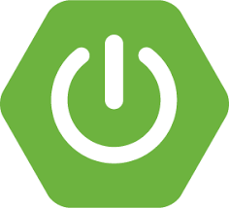
Management Endpoints (Actuators)
Available in Steeltoe 1.1-rc3 and above
/info arbitrary app info, e.g. git build tag
/health application health information
/trace circular buffer of last 100 http requests/responses
/loggers shows and modifies configuration of loggers down to the class level
Notes:
Steeltoe helps you manage and troubleshoot your application by exposing standard (from Spring Boot) management endpoints (aka Spring Boot Actuators)
In Steeltoe 1.1 we will include these 4 endpoints that will automatically get bound to your application

Slide 17
Open Source and Flexible
Steeltoe works...
with .NET Core and with the .NET framework
on Windows and on Linux
standalone and running on Cloud Foundry
...and it’s now part of the
Notes:
.NET Foundation announced in November 2017

Slide 18
Availability & New Features

Slide 19
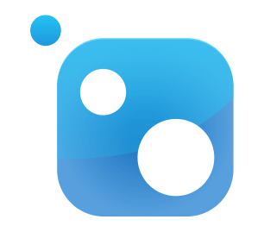
Availability
Packages are available on NuGet.org
2.1.0 (GA) available now!
2.0.0 (GA) released Feb. 16, 2018
1.0.0 (GA) released Mar. 31, 2017
1.0.0-rc2 released Dec. 2016
1.0.0-rc1 released Oct. 2016
Notes:
2.0.0 coming soon

Slide 20
Features
2.1 (Available Now)
Full ANC 2.1 support
Tracing with Open Census and Zipkin exporter
Metrics Forwarding and Open Census Metrics support
Out-of-the-box Health Contributors for connectors
New Actuators Endpoints - /refresh, /env
Notes:
Currently the Eureka client uses a random function to load balance calls to apps. Ribbon would introduce Round-Robin (and other pluggable load balancing algorithms)

Slide 21



How to get started
The best way to get started is to take a look at our docs, clone a sample from the GitHub repo, and contact the team in Slack with questions and feedback.
Learn more → http://steeltoe.io
Check out the samples → https://github.com/steeltoeoss
Get the bits → https://www.nuget.org/profiles/steeltoe
Talk to us → http://slack.steeltoe.io/
Tell your friends → @SteeltoeOSS

